Slide 1

Basic Details of the Team and Problem Statement
Ministry/Organization Name/Student Innovation: Ministry of social justice and Empowerment, composite regional center(CRC Srinagar), Department of Empowerment of Person with Disabilities.
PS Code: RK755
Problem Statement Title: Tracing Ip Address and details of unidenified participants while academic sessions
Team Name: The Whack Hack
Team Leader Name: Gourav Singal
Institute Code (AISHE): U-1056
Institute Name: Netaji Subhas University Of Technology
Theme Name:

Slide 2
Idea/Approach Details
Describe your idea/Solution/Prototype here:
We are creating a React App which will be connected
with the python backend server.
We will provide host the ability to create/schedule meetings and invite the participants by their emails, the participants will be authenticated by the password/otp and the email.
During the meeting there will be the live transcripts of all the participants which will be montiored by the python backend server, the server will identify offensive behaviour and report it to back to the host and also provide participants ability to report the host/other participants which will be furthur repoted to the admin.
All the recordings of the meeting will be deleted immediately after the meeting except for the reported conversation and context.
for the prototype intially we are implementing for support only english language but for the final submission we will implement multi lingual model which will be better suited for india.
Technology and dependencies:
1. React - Frontend
2. Python - backend
3. Mongodb/firebase for database
4. Speech recognition api
5. Spacy(NLP) for converting word into vector
6) LSTM/GRU for text classification
7) CoAtNet-7 model for image classification
8) Axios for data transfer

Slide 3
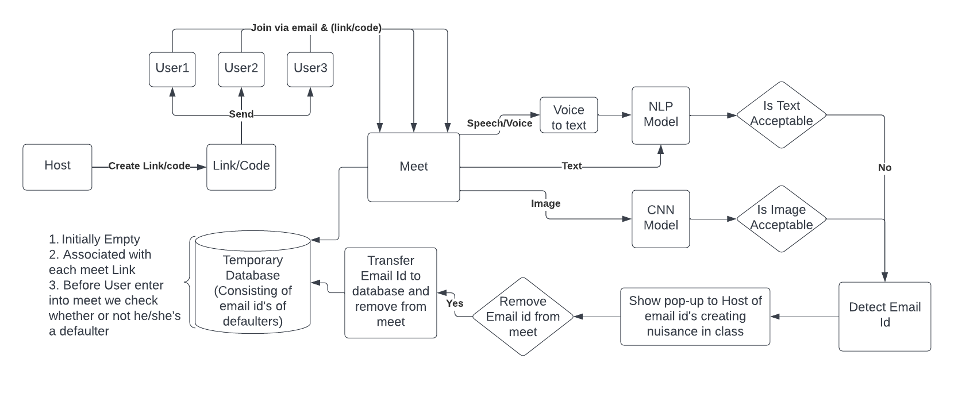
Flow Chart

Slide 4
Idea/Approach Details
Describe your Use Cases here
1. Team meetings: Festivals and other ocassional meets
2. Sales demos: In domestic and international business
3. Training: For all types of trainings like government.
4. Education: In colleges, schools and other institutionals organisations.
5. Entertainment: To play onlines games and chatting.
6. Online Events: Interviews and sessions conduction

Slide 5
Team Member Details
Team Leader Name: Gourav Singal
Branch (Btech) Stream (COE) Year (III)
Team Member 1 Name: Shweta
Branch (Btech) Stream (EE) Year ((III)
Team Member 2 Name: Vatsal
Branch (Btech) Stream (COE) Year (III)
Team Member 3 Name: Shivam Sharma
Branch (Btech) Stream (COE) Year (III)
Team Member 4 Name: Mayank Goel
Branch (Btech) Stream (COE) Year (III)
Team Member 5 Name: Shivam Gupta
Branch (Btech) Stream (COE) Year(III)
Team Mentor 1 Name: Dr. Mohinder Pal Singh Bhatia
Category (Academic)): Expertise (Software Engineering): Domain Experience (30+ years):
Team Mentor 2 Name: Manu Sheel Gupta
Category (Academic)): Expertise (UI/UX, Design software, Backend Engineering): Domain Experience (15+ years):

Slide 6
Important Pointers
Please ensure below pointers are met while
Kindly keep the maximum slides limit to 4 pages
All the topics should be utilized for description of your idea
Try to avoid paragraphs and post your idea in points
Keep your explanation precisely and easy to understand
Idea should be unique and novel. If it has a business potential more weightage will be given.
Apart from this PPT abstract of your idea will be asked separately while submitting
You need to save the file in PDF and upload the same on portal. No PPT, Word Doc or any other format will be supported
You can delete this slide (Important Pointers) when you upload the details of your idea on SIH portal.

